Slide 1
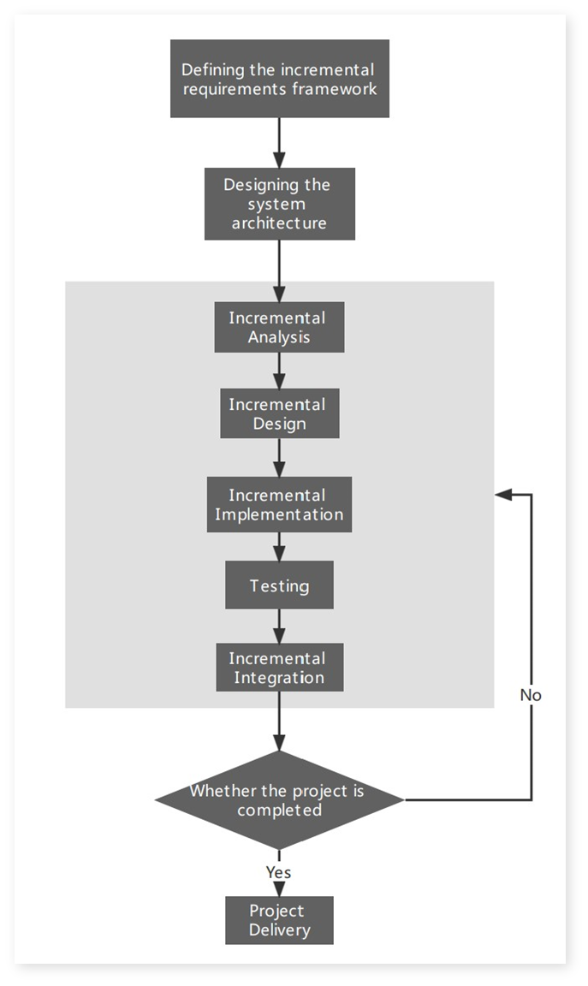
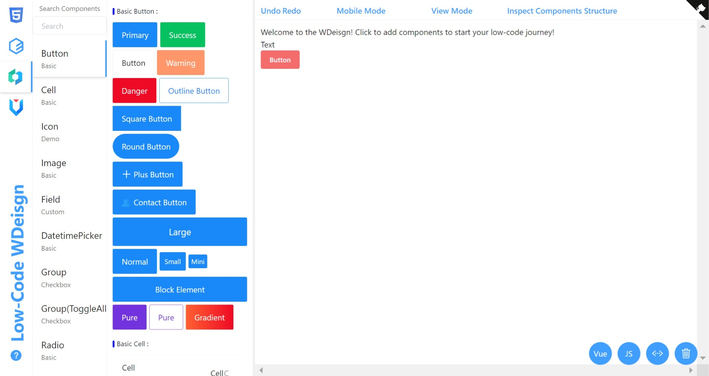
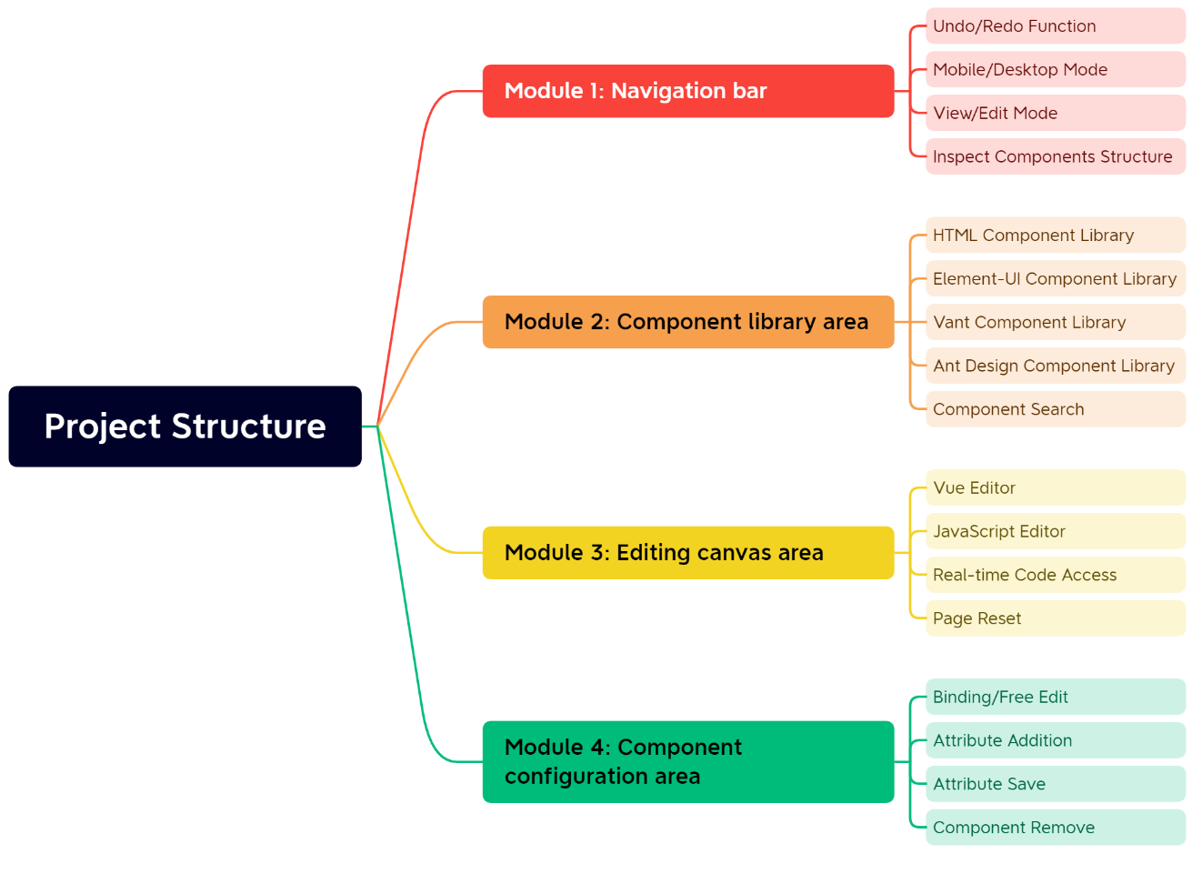
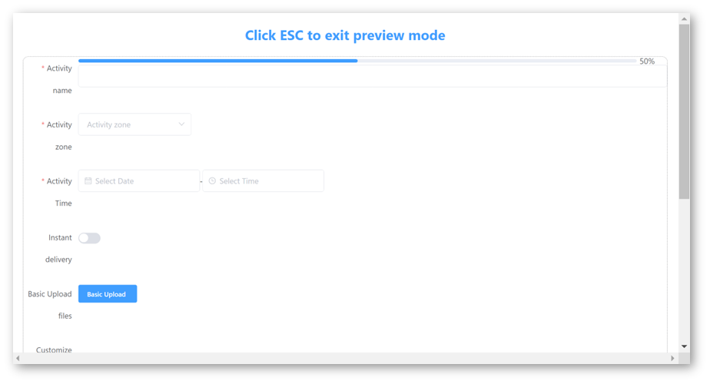
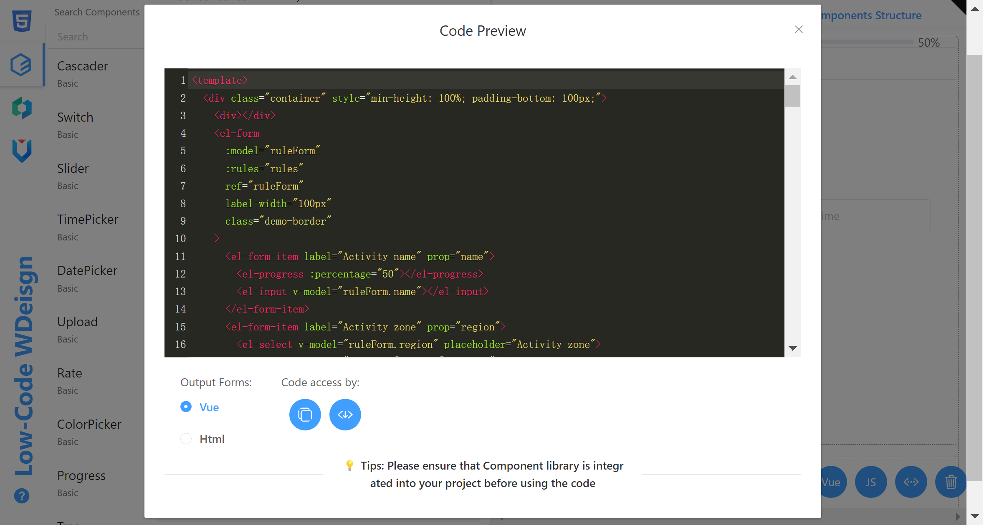
Web Design Platform Based on Low-Code Visual Components
Student: Ruitong Xiao (Aurora) | Supervisor: Javier Jia
Introduction
This project introduces a low-code development platform (LCDP) that leverages visual components to empower citizen developers in designing websites with minimal hand-coding. The primary objective is to mitigate costs, enhance efficiency, and expedite time-to-market.
The report undertakes a comparative analysis of three commercial LCDPs, evaluating their features, strengths, and weaknesses. By enabling citizen developers [1] to create applications through visual interfaces, minimal coding, and prebuilt components, the project offers benefits across organizations of all sizes and industries [2].
Overall, low-code development emerges as an efficient alternative to traditional application development [3], driven by the principles of visualization, drag and drop functionality, and model-driven engineering.
Methodology
Result
Incremental Development Model
Project Structure
Editing Page
Navigation bar
Provides the functions of Undo/Redo, Mobile/Desktop Mode, View/Edit Mode and Inspect Components Structure.
The project consists of four main modules:
Navigation bar for page editing and previewing.
Component library area for integrating component libraries and basic HTML elements.
Editing canvas area for code editing, previewing, and page deletion.
Component configuration area for editing component properties.
Component Library Area
Provides three different component libraries and the functionality to search for components, but only within the currently selected component library.
Screenshot 1. Editing Page
Editing Canvas Area
Providing functions such as web code editing, preview, and web page deletion
Figure 2. Project Structure Diagram
Figure 1.Incremental Development Model Flowchart
The incremental model was chosen to be the software development method for this project, decomposing the project into multiple interrelated task modules in accordance with the various functional requirements.
1
Page Preview
2
Code Preview
Provide visual page preview function, view the effect of the web page through the web preview function during the web page editing process.
Provides real-time code modification and copying, as well as download projects in different output formats such as Vue and HTML.
Requirements Gathering Methods
Competitive Feature Analysis
Technology
Xmind
ProcessOn
Figma
Vue and Vite
Visual Studio Code
Selenium IDE
PyCharm
Design Tools
Development Tools
Screenshot 3. Page Preview
Screenshot 4. Code Preview
Conclusion
References
The development of an LCDP using visual components has successfully addressed the needs of citizen developers, reducing costs and improving efficiency compared to traditional application development.
The platform, built on modern technologies like Vue3 and Vite, offers a range of features such as drag-and-drop components, code editing, and export functionality.
Rigorous testing has proven its stability and exceptional user experience.
While challenges remain, such as a learning curve and limited customization, the LCDP presents a promising solution for citizen developers.
Further exploration and research in this area can lead to improved solutions and significant long-term benefits.
[1] M. Oltrogge et al., ‘The Rise of the Citizen Developer: Assessing the Security Impact of Online App Generators’, in Proceedings - IEEE Symposium on Security and Privacy, Jul. 2018, vol. 2018-May, pp. 634–647. doi: 10.1109/SP.2018.00005.
[2] P. Vincent et al., ‘Magic Quadrant for Enterprise Low-Code Application Platforms’, 2020. [Online]. Available: https://www.gartner.com/doc/reprints?id=1-24BBDEDZ&ct=201005&st=sb
[3] A. C. Bock and U. Frank, ‘In Search of the Essence of Low-Code: An Exploratory Study of Seven Development Platforms’, in Companion Proceedings - 24th International Conference on Model-Driven Engineering Languages and Systems, MODELS-C 2021, 2021, pp. 57–66. doi: 10.1109/MODELS-C53483.2021.00016.
Contact details xiao.ruitong@student.zy.cdut.edu.cn
Dept.
CDUT Sino-British Collaborative Education,
Oxford Brookers University, Chengdu, Sichuan, China

